Slide 1

FALL 2023
MIS 381N
Information management
Lecture 6
Sept 11th 2023
Prashant D. Joshi
UT McCombs School of Business (MSBA), The University of Texas at Austin

Slide 2

Objectives
Indexes and Sequences
Physical Design-DDL: Indexes, Sequences and Views
In-class practice
Questions and discussion

Slide 3
What questions may I answer before we begin …
All questions are good questions

Slide 4
Housekeeping

Slide 5
Physical Design/DDL

Slide 6
SQL Overview

Slide 7
Drop Table Syntax
DROP TABLE [ schema. ]table
[ CASCADE CONSTRAINTS ]
[ PURGE ] ;
[ ] - optional

Slide 8
Alter Table Syntax
ALTER TABLE [schema_name.] table_name {
ADD column_name data_type [column_constraint] […]
|
DROP COLUMN column_name
|
MODIFY column_name data_type [column_constraint] […]
}
[ ] – optional
| - OR
Oracle won’t allow you to change a column if that change would cause data to be lost

Slide 9
Index

Slide 10
Conceptual Discussion - Indexes
What is the purpose of an index?
Speed up search
Speed up joins
What should be an index?
Oracle creates indexes for primary keys and unique constraints of a table
Foreign keys are good candidates for indexes
Columns that are frequently used in queries are also good candidates for indexes

Slide 11
Conceptual Discussion – Indexes
In practice how are indexes identified?
When you have a query that is slow
By analyzing database usage
By analyzing “stats” captured by Oracle
What is the downside to an index?
When indexes are created on columns that are updated frequently, performance of insert, update and delete operations are impacted
Naming convention
TableName_ColumnName(s)_ix

Slide 12
Create Index Syntax
CREATE [UNIQUE] INDEX index_name
ON table_name (column_name_1 [ASC | DESC]
[, column_name_2 [ASC | DESC] …)
[ ] – optional
UNIQUE – index contains only unique values
ASC – sort order by default
Indexes can use functions over columns (we will learn about functions later)

Slide 13
Index Syntax
The syntax of the CREATE INDEX statement
CREATE [UNIQUE] INDEX index_name
ON table_name (column_name_1 [ASC|DESC]
[, column_name_2 [ASC|DESC]]...)
A statement that creates an index based on a single column
CREATE INDEX invoices_vendor_id_ix
ON invoices (vendor_id);
A statement that creates an index based on two columns
CREATE INDEX invoices_vendor_id_inv_no_ix
ON invoices (vendor_id, invoice_number);
A statement that creates a unique index
CREATE UNIQUE INDEX vendors_vendor_phone_ix
ON vendors (vendor_phone);
A statement that creates an index that’s sorted in descending order
CREATE INDEX invoices_invoice_total_ix
ON invoices (invoice_total DESC);
TIP: Use a standard naming convention for readability. e.g. table_column_ix

Slide 14
Create Index Syntax
Practice:
1. What would be likely fields to create an index on for the invoice table?
2. Create an index on vendor_id. Why?
3. Create an index on invoice_date why? Should we consider sorting? Create index.
Index Syntax using table_field_ix naming standard
-- Create the indexes
CREATE INDEX vendors_terms_id_ix
ON vendors (default_terms_id);
CREATE INDEX vendors_account_number_ix
ON vendors (default_account_number);

Slide 15
What are good candidates for Indexes?
CompletedRegistration
IsGradedFor
N
CompRegistrationId(PK)
StudentId(FK)
CourseId(FK)
Grade (A, B, C, D, F)
Course
N
1
CanHave
Student
CourseId(PK)
CourseName
CourseMandatory (Y, N)
StudentId(PK)
StudentFirstName
StudentLastName
StudentAddress
StudentDoB
1
ActiveRegistration
CanHave
1
ActiveRegistrationId(PK)
StudentId(FK)
CourseId(FK)
IsRegisteredFor
N
7

Slide 16
Create Index Syntax
A statement that creates a function-based index
CREATE INDEX vendors_vendor_name_upper_ix
ON vendors (UPPER(vendor_name));
Another statement for a function-based index
CREATE INDEX invoices_balance_due_ix
ON invoices (invoice_total - payment_total - credit_total DESC);
How to enable function-based indexes
CONNECT system/system;
ALTER SYSTEM SET QUERY_REWRITE_ENABLED=TRUE;
A statement that drops an index
DROP INDEX vendors_vendor_state_ix

Slide 17
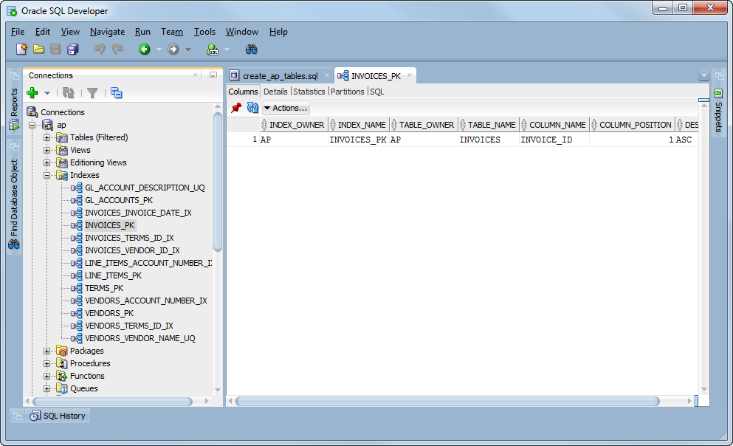
Indexes for the A/P Schema

Slide 18
Sequences

Slide 19
Conceptual Discussion – Sequences
What is the purpose of a sequence?
Automatically generate a sequence of integer values
Used to generate a value for a primary key
How are sequences used?
Two step process:
Create the sequence
Assign the sequence to the primary key as a default value – this is one way, there are other ways but for now this is good
Naming convention
TableName_ColumnName_seq

Slide 20
Create Sequence Syntax
CREATE SEQUENCE [ schema. ] sequence
[ { INCREMENT BY | START WITH } integer
| { MAXVALUE integer | NOMAXVALUE }
| { MINVALUE integer | NOMINVALUE }
| { CYCLE | NOCYCLE }
| { CACHE integer | NOCACHE }
| { ORDER | NOORDER }
]

Slide 21
Create Sequence Syntax
Let’s Clarify:
Cycle = return to zero after seq hits the max value
Cache = Saves the next set of numbers in the seq in memory to speed up performance. Default cache is 20.
Order = Guarantees the numbers generated in order of request. Only used in unique application design situations

Slide 22
Create Sequence Syntax
A statement that creates a sequence
CREATE SEQUENCE vendor_id_seq
A statement that specifies a starting integer
CREATE SEQUENCE vendor_id_seq
START WITH 124
A statement that specifies all parameters
CREATE SEQUENCE test_seq
START WITH 100 INCREMENT BY 10
MINVALUE 0 MAXVALUE 1000000
CYCLE CACHE 100;
Practice:
Create a sequence called member_id_seq that starts at 10 and increments by 1.
Run test INSERT statements and confirm sequence was created correctly and works
Update the DDL provided to default the member_id column to the next value of the newly created sequence
Run 2nd test INSERT statements and then confirm member_id defaults correctly
Example: How to use a sequence as the default value
CREATE TABLE invoices
(
invoice_id NUMBER DEFAULT invoice_id_seq.NEXTVAL PRIMARY KEY,
invoice_date DATE NOT NULL
)

Slide 23
Create Sequence Syntax
The syntax of the ALTER SEQUENCE statement
ALTER SEQUENCE sequence_name
[sequence_attributes]
A statement that alters a sequence
ALTER SEQUENCE test_seq
INCREMENT BY 9
MINVALUE 99 MAXVALUE 999999
NOCYCLE CACHE 9 NOORDER;
A statement that drops a sequence
DROP SEQUENCE test_seq;
Practice
5. Update member_id_seq to increment by 10 instead of 1
6. Rerun 2nd test INSERTS and SELECT to see if they still worked.
7. Drop member_id_seq

Slide 24
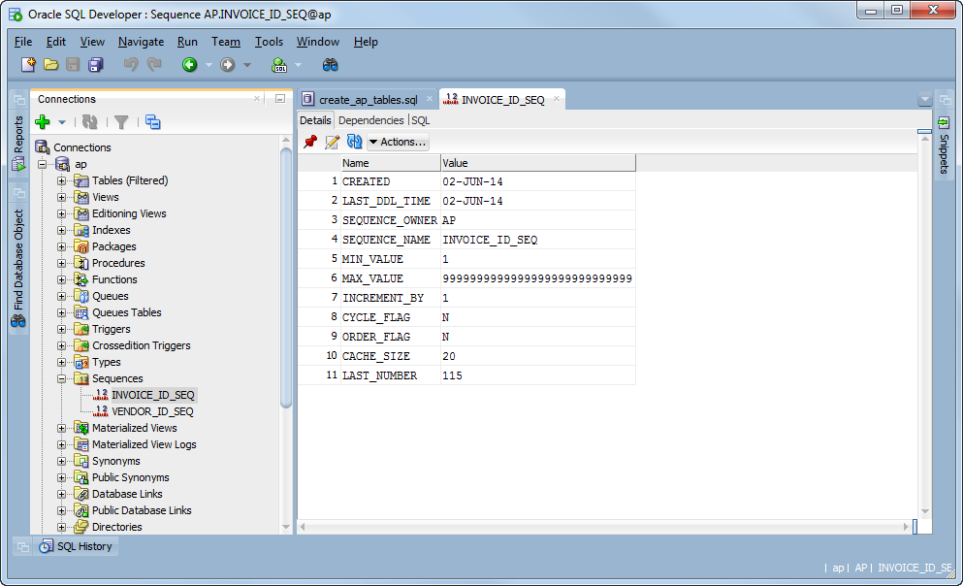
Sequences for the A/P schema

Slide 25
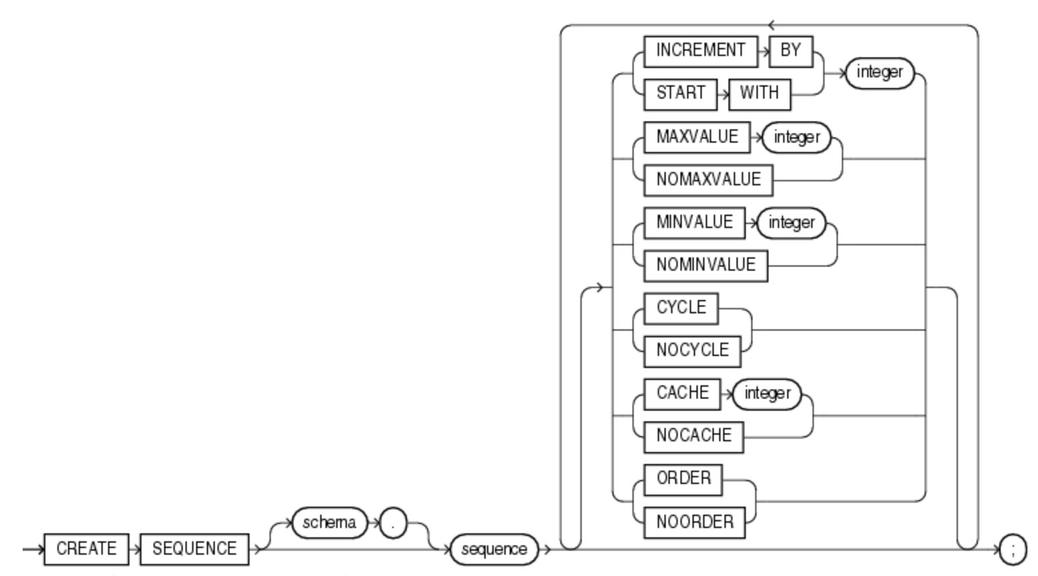
Create Sequence Syntax

Slide 26
Create Sequence Syntax (alternate)
CREATE TABLE Persons ( Personid int NOT NULL AUTO_INCREMENT, LastName varchar(255) NOT NULL, FirstName varchar(255), Age int, PRIMARY KEY (Personid) );
ALTER TABLE Persons AUTO_INCREMENT=100;
--If you wanted to start incrementing from a number other than the default 1
INSERT INTO Persons (FirstName,LastName) VALUES (’James’, ’Bond');

Slide 27
What are good candidates for Sequences?
N
CompletedRegistration
IsGradedFor
CompRegistrationId(PK)
StudentId(FK)
CourseId(FK)
Grade (A, B, C, D, F)
Course
N
1
CanHave
Student
CourseId(PK)
CourseName
CourseMandatory (Y, N)
StudentId(PK)
StudentFirstName
StudentLastName
StudentAddress
StudentDoB
1
ActiveRegistration
CanHave
1
ActiveRegistrationId(PK)
StudentId(FK)
CourseId(FK)
IsRegisteredFor
N
7

Slide 28
Views

Slide 29
Conceptual Discussion – Views
What is the purpose of a view?
Package data for a specific “purpose” by combining selected data from multiple tables
A purposeful “package of data” is called a ”view”
How are views used? Views are used for the following three purposes:
Application developers so that they can be independent of the database design for viewing and updating data.
Business analysts so that they can query data without joins
Security enforcement and data segregation

Slide 30
Create View Syntax
CREATE [OR REPLACE] [{FORCE | NOFORCE}] VIEW view_name
[(column_alias_1 [, column_alias_2] …)]
AS
select data from tables using select statement that we will learn later

Slide 31
What types of views would be helpful?
N
CompletedRegistration
IsGradedFor
CompRegistrationId(PK)
StudentId(FK)
CourseId(FK)
Grade (A, B, C, D, F)
Course
N
1
CanHave
Student
CourseId(PK)
CourseName
CourseMandatory (Y, N)
StudentId(PK)
StudentFirstName
StudentLastName
StudentAddress
StudentDoB
1
ActiveRegistration
CanHave
1
ActiveRegistrationId(PK)
StudentId(FK)
CourseId(FK)
IsRegisteredFor
N
7

Slide 32
Example view
Student
CompletedRegistration
Course
StudentId(PK)
StudentFirstName
StudentLastName
StudentAddress
StudentDoB
CompRegistrationId(PK)
StudentId(FK)
CourseId(FK)
Grade (A, B, C, D, F)
CourseId(PK)
CourseName
CourseMandatory (Y, N)
StudentGradeView
StudentId
StudentFirstName
StudentLastName
CourseId
CourseName
Grade

Slide 33
Practice Break out teams

Slide 34
Practice Model
N
CompletedRegistration
IsGradedFor
CompRegistrationId(PK)
StudentId(FK)
CourseId(FK)
Grade (A, B, C, D, F)
Course
N
1
CanHave
Student
CourseId(PK)
CourseName
CourseMandatory (Y, N)
StudentId(PK)
StudentFirstName
StudentLastName
StudentAddress
StudentDoB
1
ActiveRegistration
CanHave
1
ActiveRegistrationId(PK)
StudentId(FK)
CourseId(FK)
IsRegisteredFor
N
7
How many tables do we need to make?

Slide 35
Alter Table Practice
Add a column CompletionDate to the CompletedRegistration table
Modify the data type of the CourseMandatory column in the Course table
Drop column CompletionDate from the CompletedRegistration table
Modify the data type of Grade column in the CompletedRegistration table and allow a Grade of “P”

Slide 36
Alter Table Syntax
ALTER TABLE [schema_name.] table_name {
ADD column_name data_type [column_constraint] […]
|
DROP COLUMN column_name
|
MODIFY column_name data_type [column_constraint] […]
}
[ ] – optional
| - OR
Oracle won’t allow you to change a column if that change would cause data to be lost

Slide 37
Alter Table Practice
Add a column CompletionDate to the CompletedRegistration table
Modify the data type of the CoureMandatory column in the Course table
Drop column CompletionDate from the CompletedRegistration table
Modify the data type of Grade column in the CompletedRegistration table and allow a Grade of “P”
Oracle won’t allow you to change a column if that change would cause data to be lost

Slide 38
Drop Table Syntax
DROP TABLE [ schema. ]table [ CASCADE CONSTRAINTS ] [ PURGE ] ;
[ ] - optional

Slide 39
Drop Table Practice
Write 4 drop statements that will run before your Create and ALTER commands to drop the tables if they exist
Make sure you drop the tables in the proper order to avoid “parentless” child tables

Slide 40
Create Index Practice
Create an index on the column CourseName for the table Course

Slide 41
Create Sequence Practice
Create a sequence for the CompRegistrationId

Slide 42
Create Sequence Example
Create a sequence for the ActiveRegistrationId
CREATE SEQUENCE ActiveRegistrationId_seq START WITH 100 INCREMENT by 10
ALTER TABLE ACTIVEREGISTRATION MODIFY ACTIVEREGISTRATIONID DEFAULT ActiveRegistrationId_seq.NEXTVAL
NEXTVAL – next value in the sequence
CURVAL – current value of the squence

Slide 43

Next class
Topic Focus: Data Manipulation Language
Read articles and review videos posted on Canvas
Come prepared to discuss and work in teams

Slide 44
https://utexas.qualtrics.com/jfe/form/SV_cG7Si64sNJrTVYO
What questions may I answer before we conclude …
All questions are good questions

Slide 45
Appendix

Slide 46
SQL Overview

Slide 48
Create Table Syntax
CREATE TABLE [schema_name.] table_name (
column_name_1 data_type [column_constraint] […],
column_name_2 data_type [column_constraint] […],
[…],
[table_level_constraints]
)
[ ] - optional

Slide 49
Data types
Common data types
Number – Number (p, s) – p is the precision, or the total number of digits, s is the scale, or the number of digits to the right of the decimal point. E.g. for Number(2, 1) the largest number that can be represented is 9.9.
Varchar2 – Varchar2 (p) specifies a variable-length character string with a maximum size of p
Date
Details: (https://docs.oracle.com/cd/A87860_01/doc/server.817/a85397/sql_elem.htm)

Slide 50
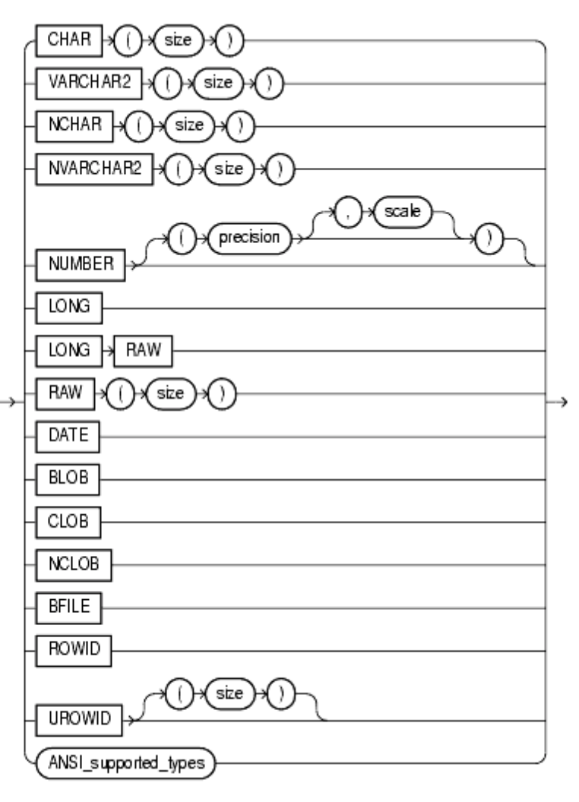
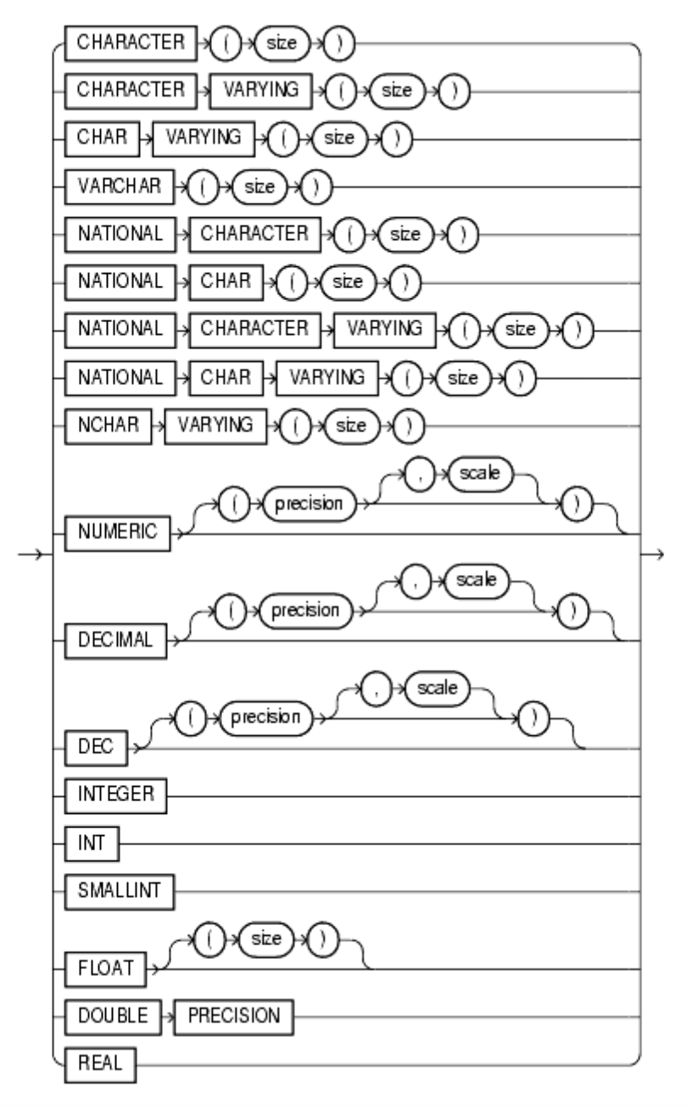
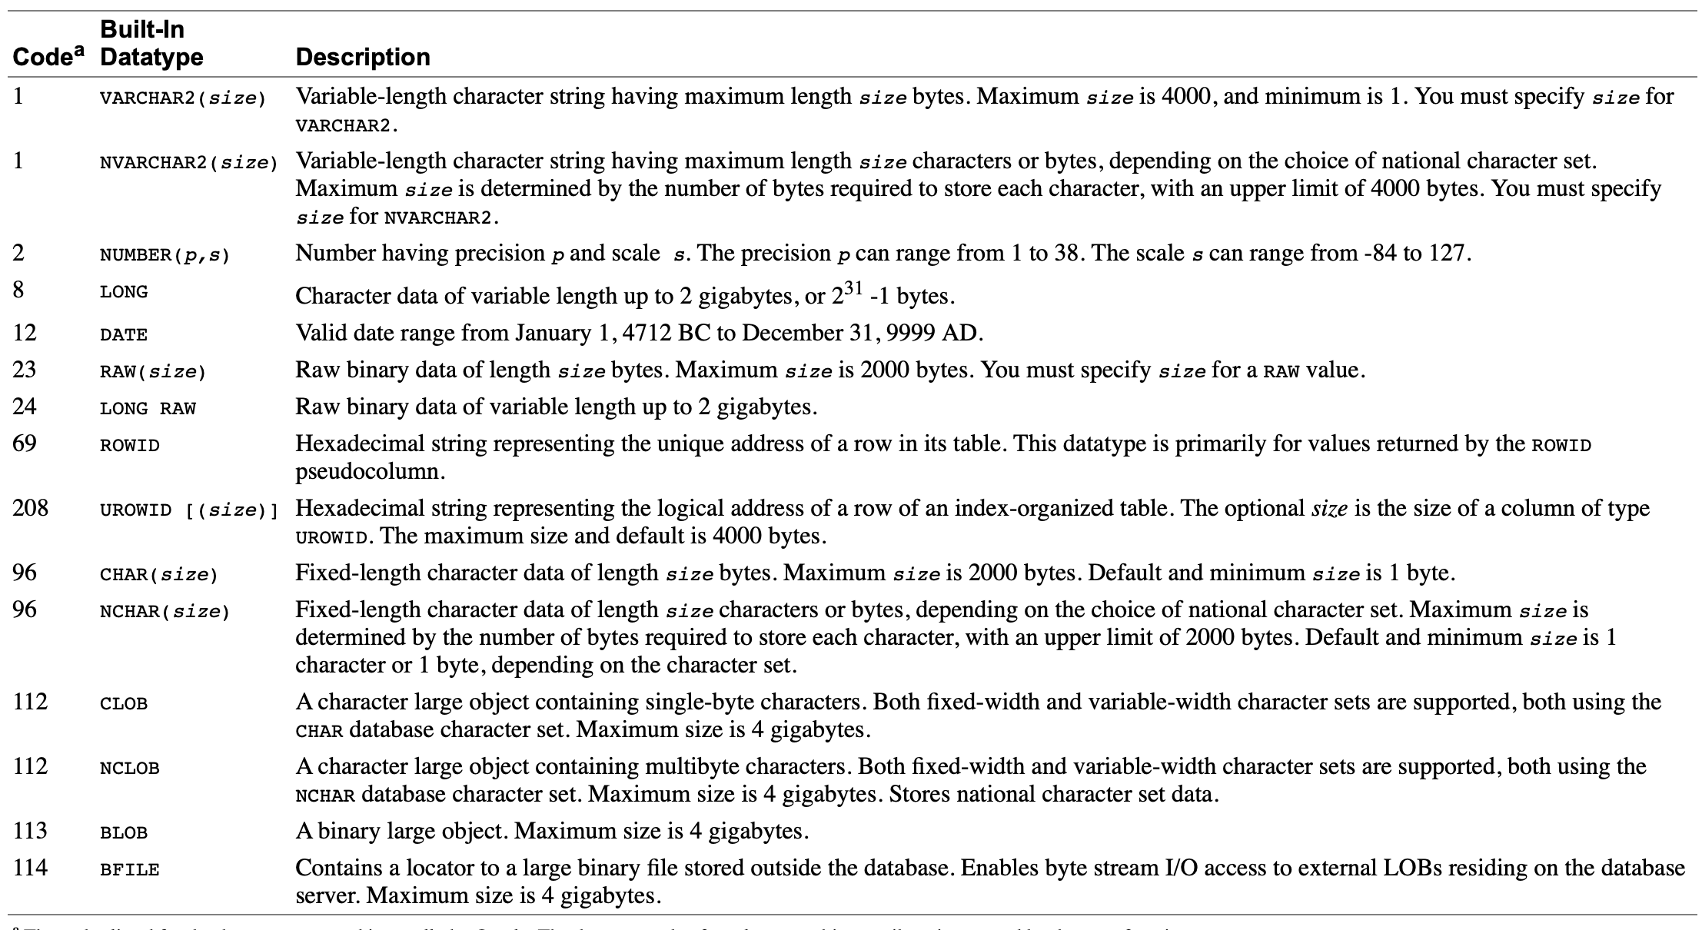
Data types
(https://docs.oracle.com/cd/A87860_01/doc/server.817/a85397/sql_elem.htm)

Slide 51
Data types
(https://docs.oracle.com/cd/A87860_01/doc/server.817/a85397/sql_elem.htm)

Slide 52
Column Constraints
A constraint is a rule that restricts the value of one or more columns. It prevents invalid data entry & prevents deletion of tables with certain dependencies.
Common column constraints
NOT NULL Specifies that this column cannot hold NULL values
PRIMARY KEY Specifies the column that uniquely identifies a row in the table. The identified columns must be defined as NOT NULL.
UNIQUE Specifies that values in the column must be unique.
FOREIGN KEY Specifies that the values in the column must correspond to values in a referenced primary key or unique key column or that they are NULL.
DEFAULT Specifies a default value for a column
CHECK Specifies rules for values in the column.
Details: (https://docs.oracle.com/javadb/10.8.3.0/ref/rrefsqlj13590.html)

Slide 53
Table Level Constraints
PRIMARY KEY Specifies the column or columns that uniquely identify a row in the table. NULL values are not allowed.
UNIQUE Specifies that values in the columns must be unique.
FOREIGN KEY Specifies that the values in the columns must correspond to values in referenced primary key or unique columns or that they are NULL. (Note: If the foreign key consists of multiple columns, and any column is NULL, the whole key is considered NULL. The insert is permitted no matter what is on the non-null columns.)
CHECK Specifies a wide range of rules for values in the table.
Details: (https://docs.oracle.com/javadb/10.8.3.0/ref/rrefsqlj13590.html)

Slide 54
Best practices to keep in mind
Cannot Combine these attributes:
PRIMARY KEY with UNIQUE
NOT NULL with DEFAULT
Consider the order in which you create tables
Make sure definitions of primary key and corresponding foreign key match
Use UPPERCASE for keywords and make sure they are spelled out correctly
Use spaces and indentation to make your code more readable
Make sure commas are only at the end of a column attribute statement
Match your parenthesis

Slide 57
Drop Table Syntax
DROP TABLE [ schema. ]table
[ CASCADE CONSTRAINTS ]
[ PURGE ] ;
[ ] - optional

